Slide 1
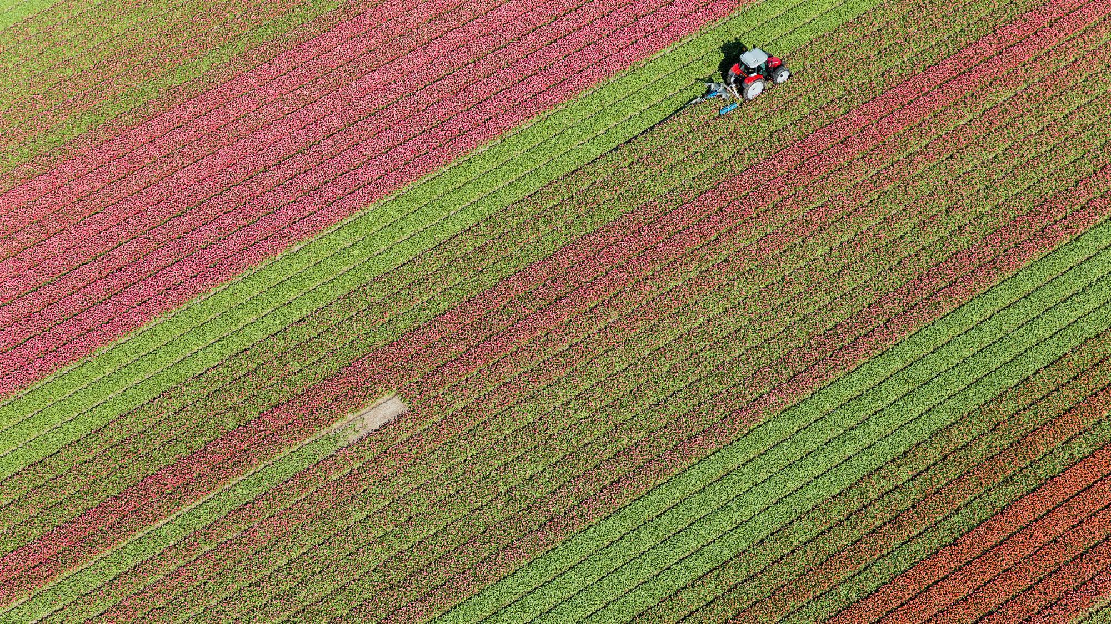
Green Booth
Team Members:
Abdalrahman Tukka, Ahmed Salem
Ahmed Yassin, Ghaiath Abdoush, Suliman Ibrahim

Slide 2
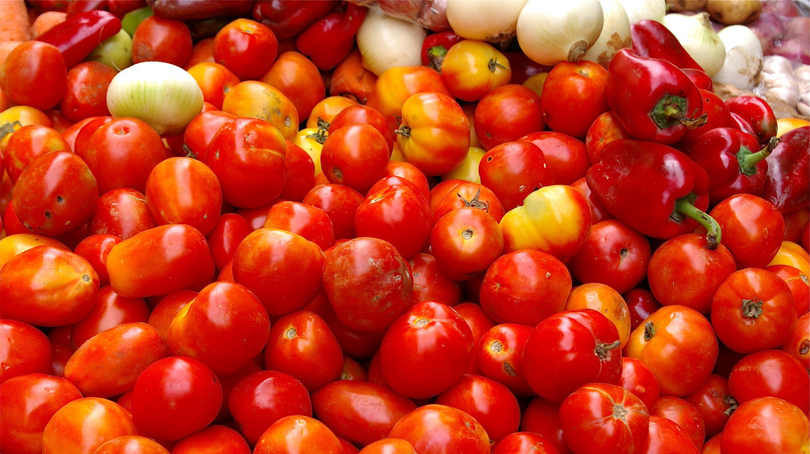
The Journey of a Tomato

Slide 3
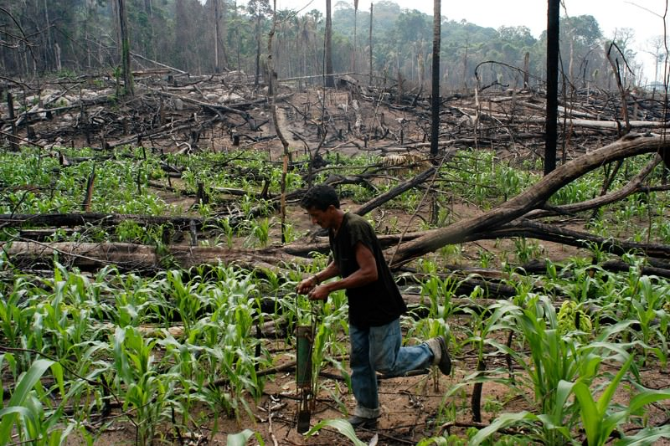
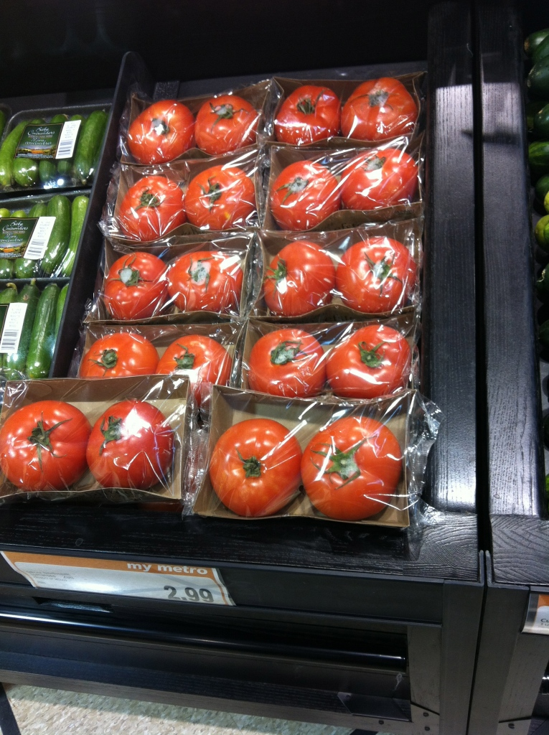
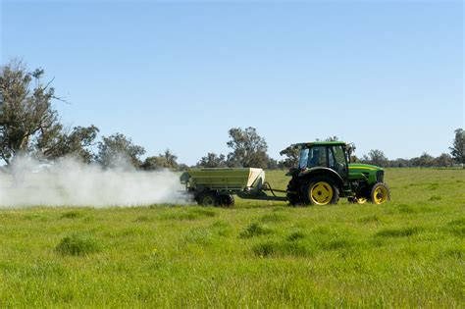
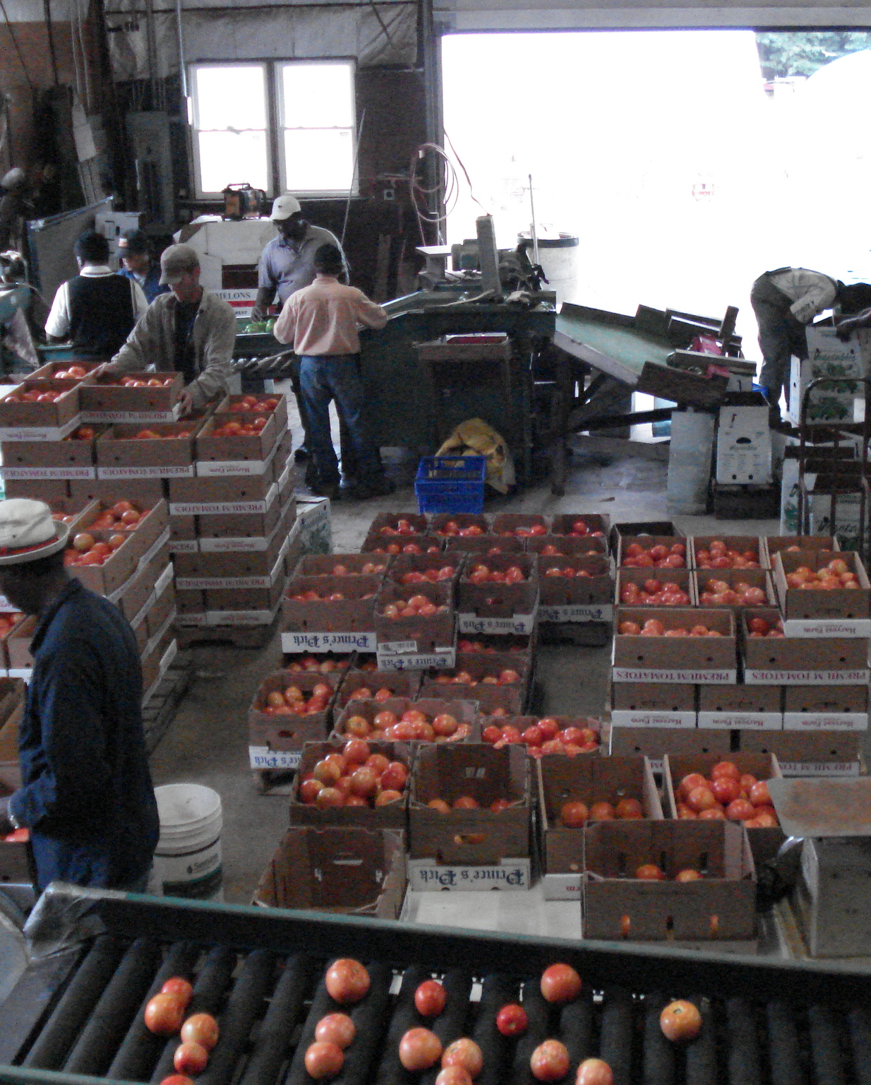
The Tomato Journey
Deforestation
Fertilizer and Farm machinery
Processing and Transportation
Retail and packaging

Slide 4
The Underling Numbers

Slide 5
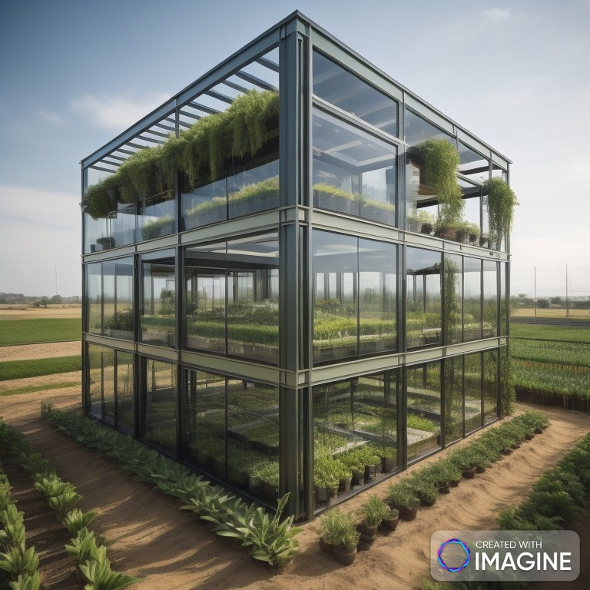
Our Solution
A Hydroponic farm that can be built and managed by individuals in low dense suburban communities

Slide 6
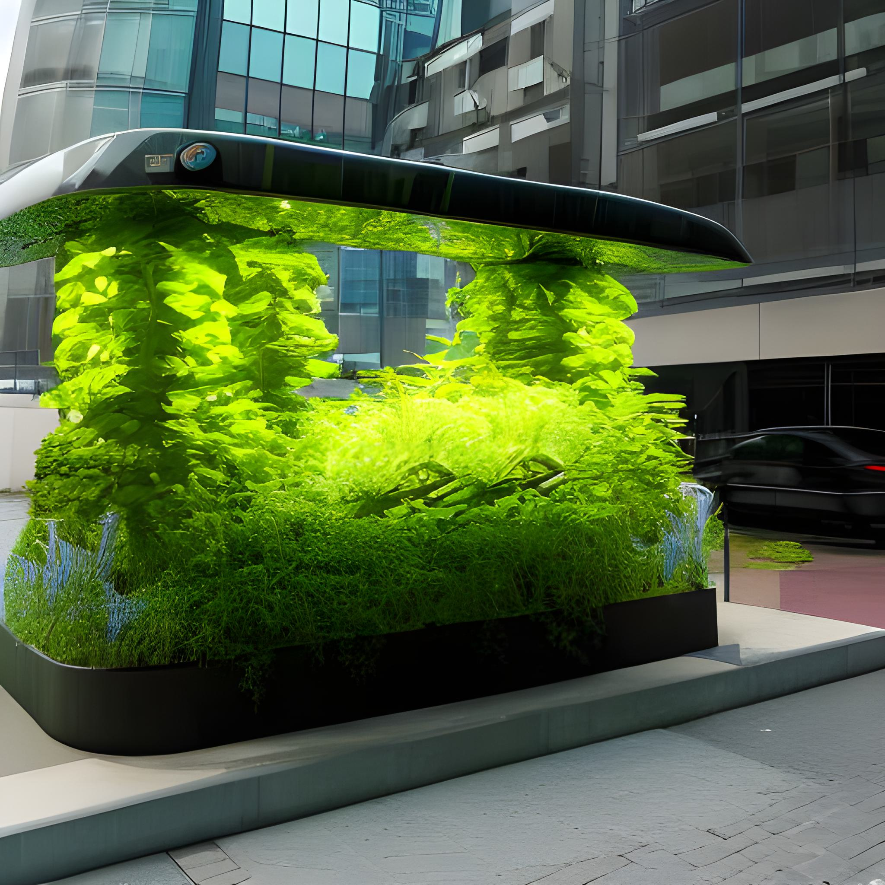
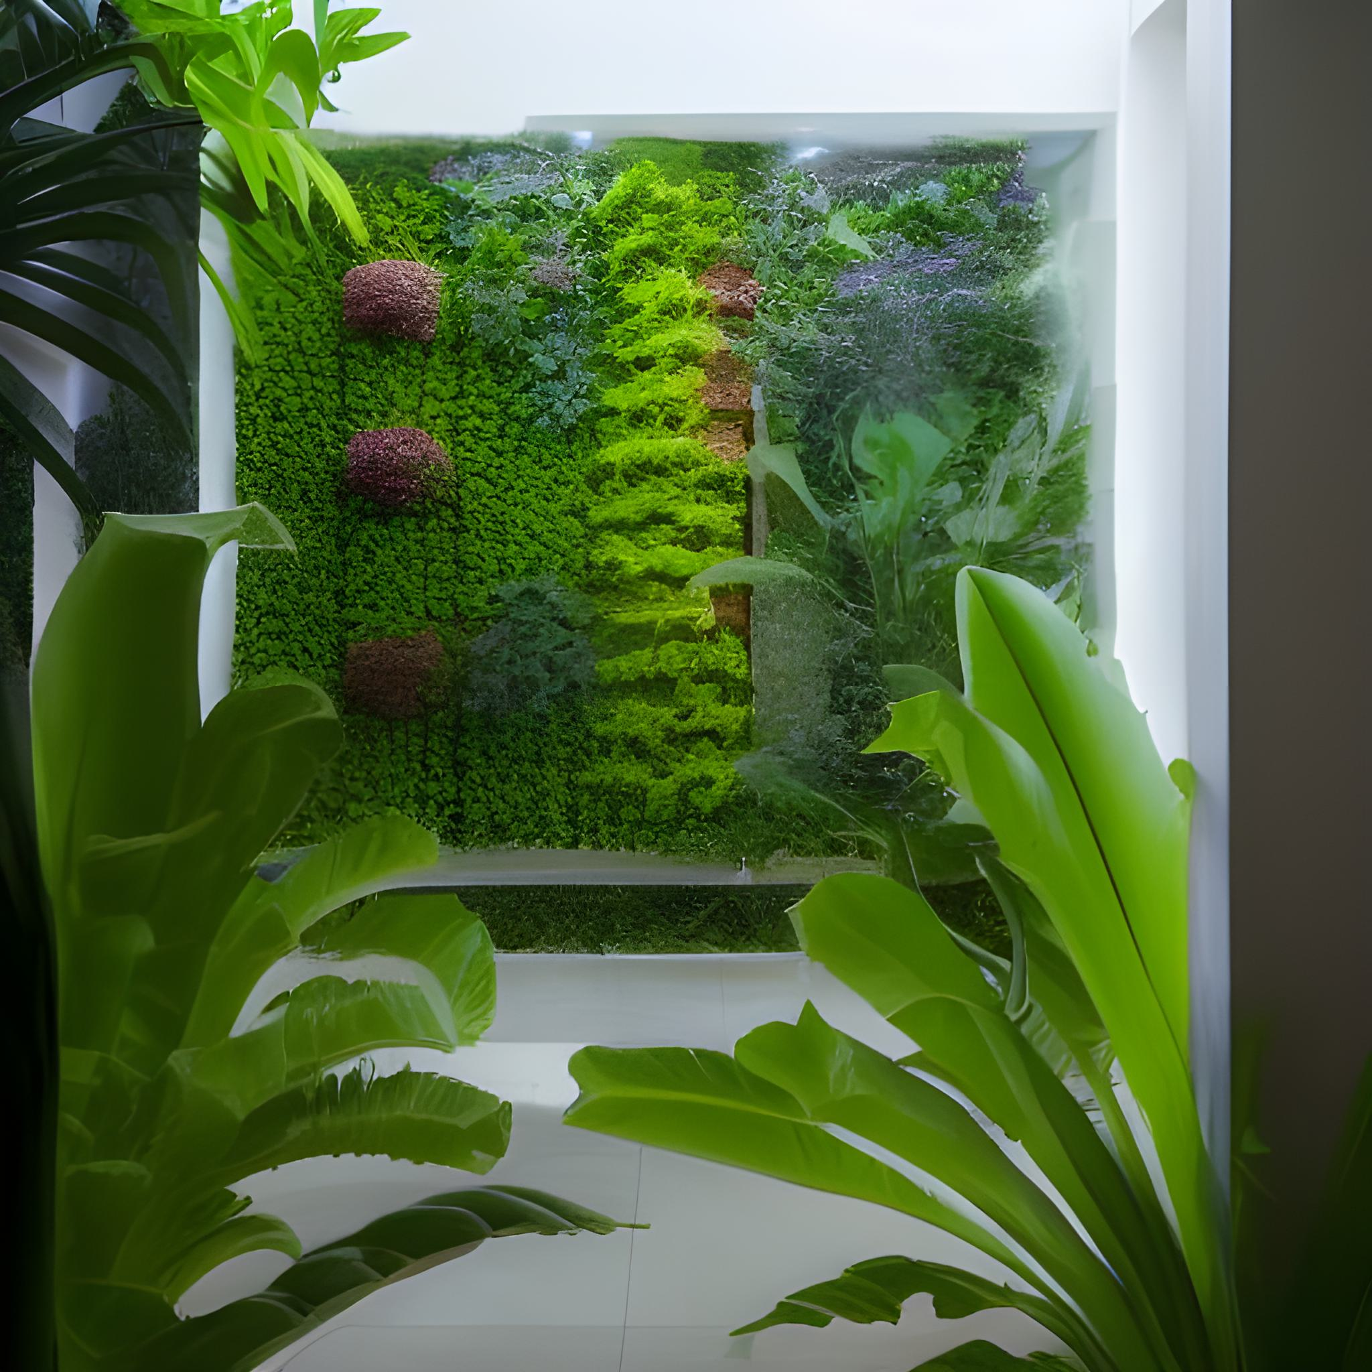
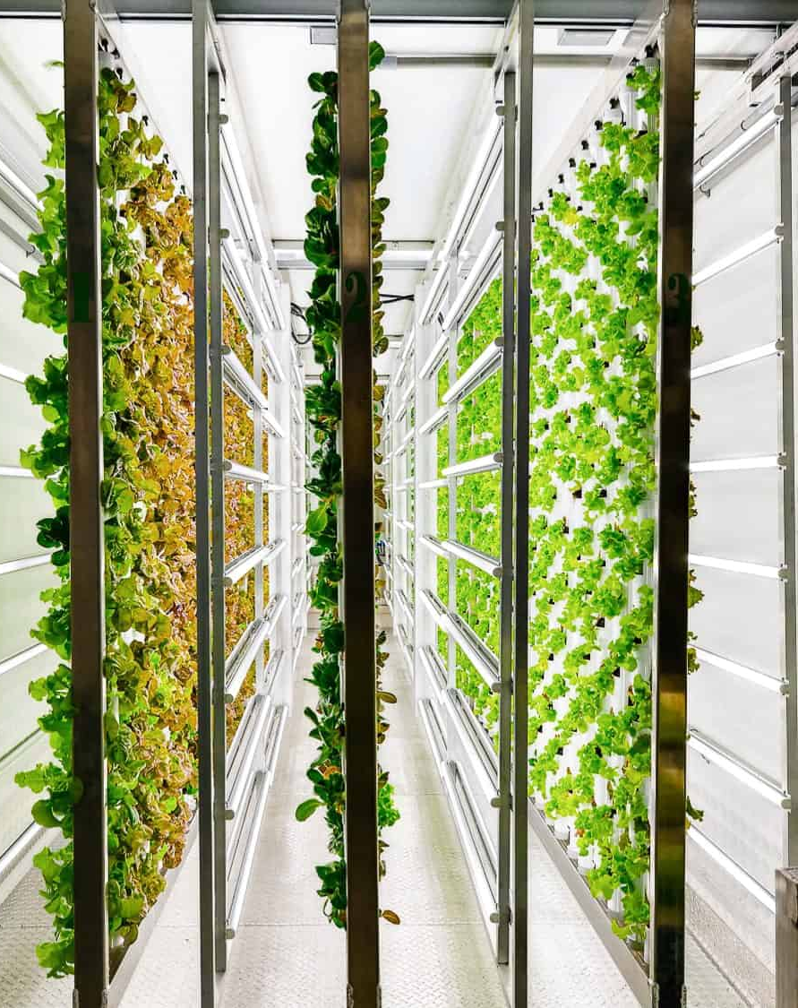
Why Hydroponic
Cut Back on water usage by a quarter
Monitor and harvest crops in controlled and measured environment
5 sq meter required to harvest 250 – 600 Kg of tomatoes

Slide 7
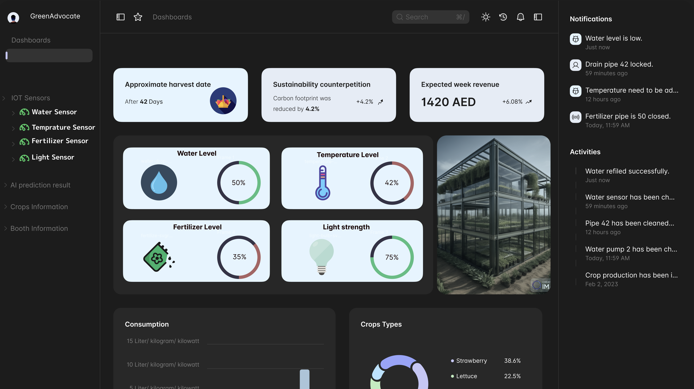

Slide 8
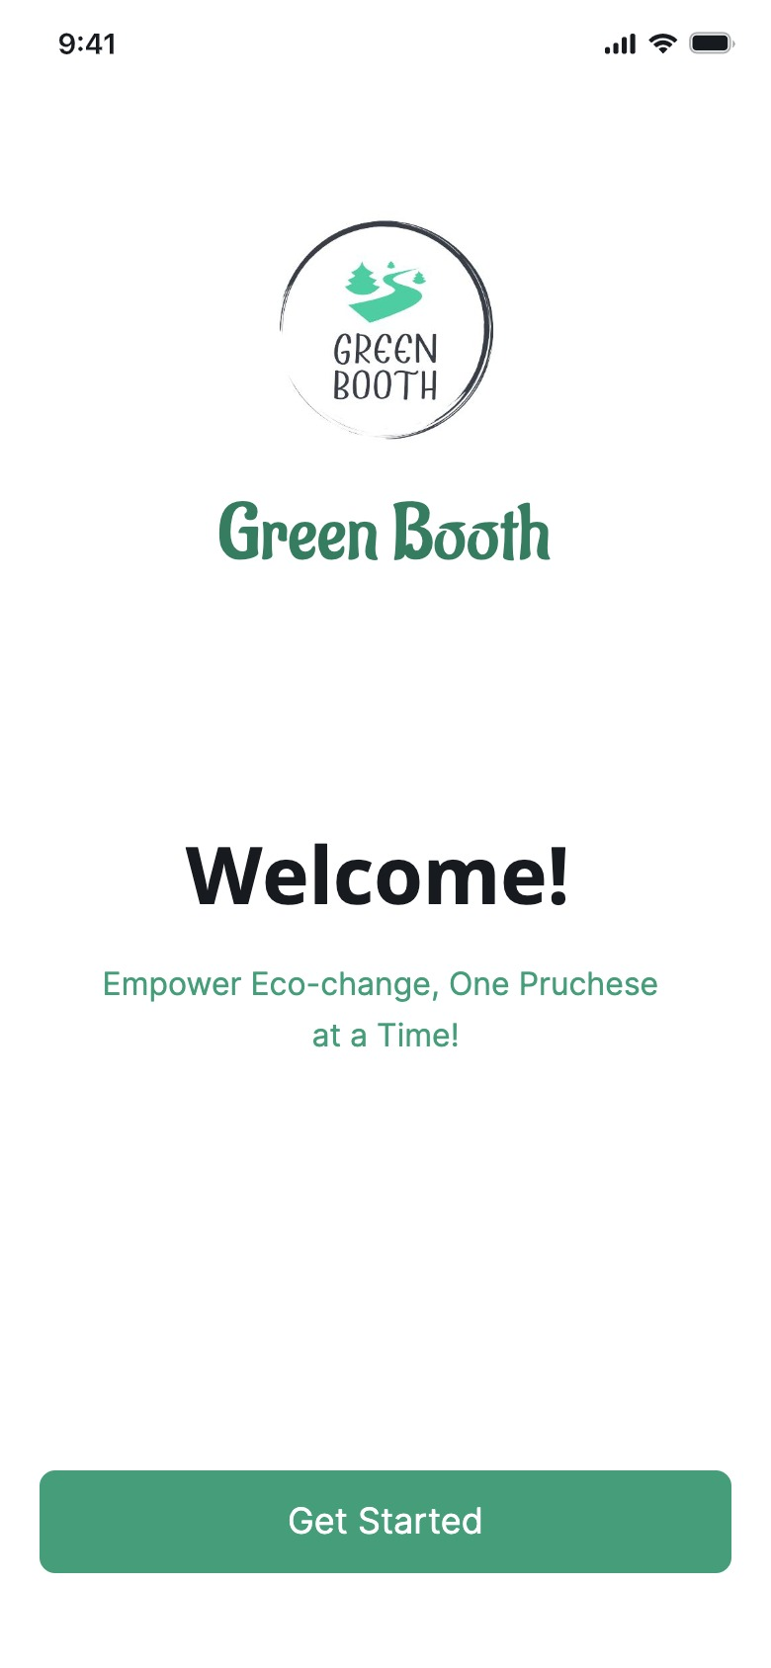
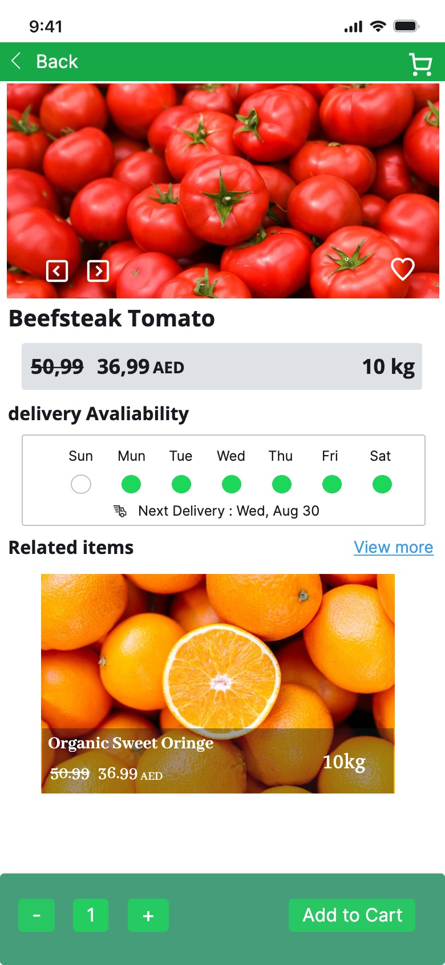
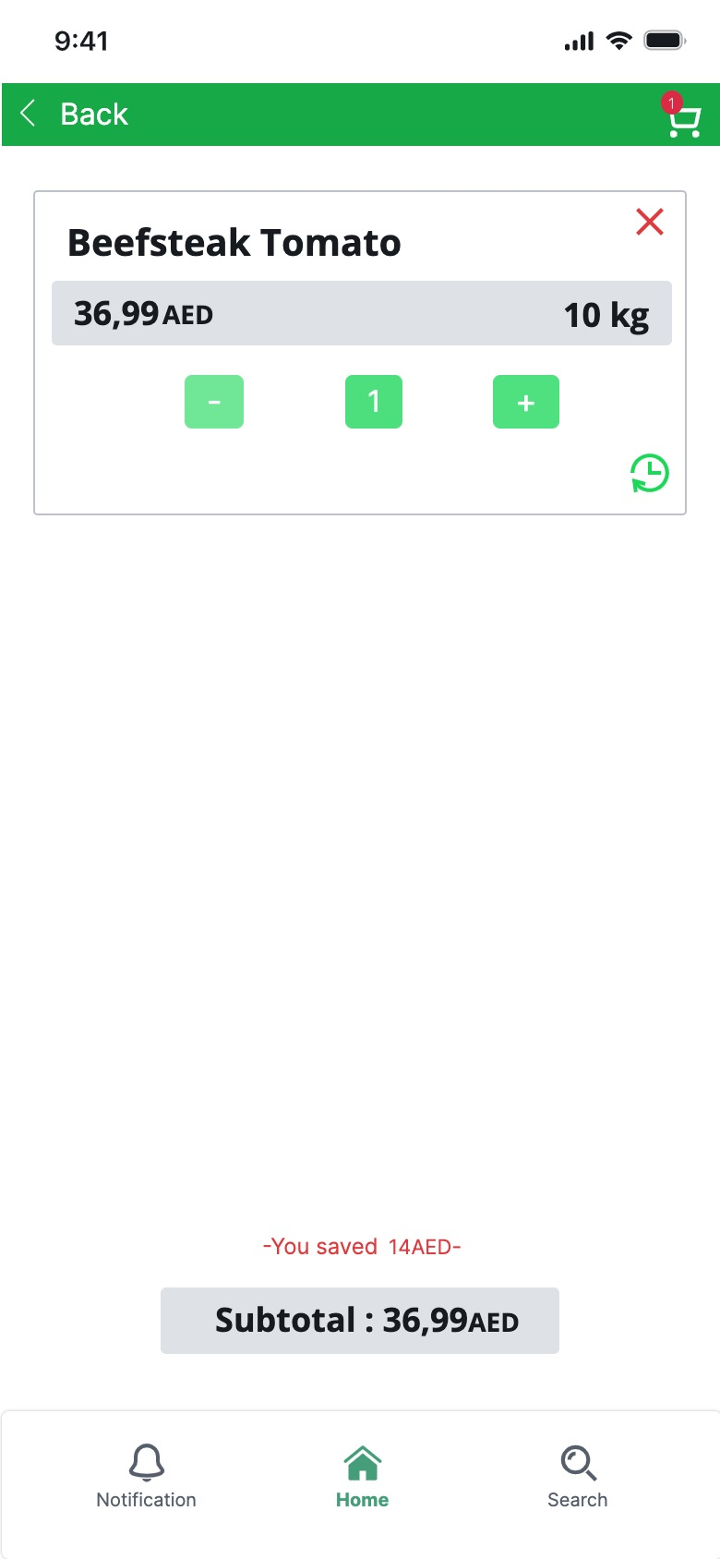
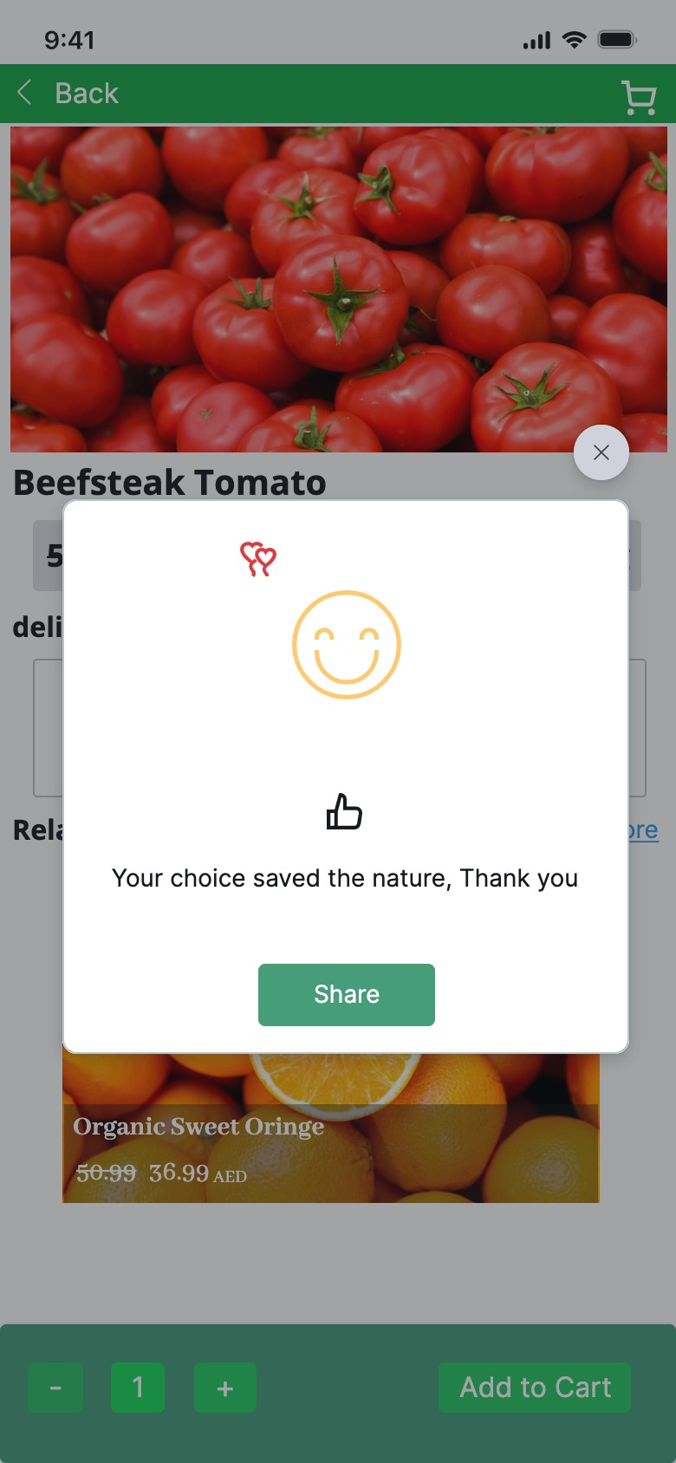
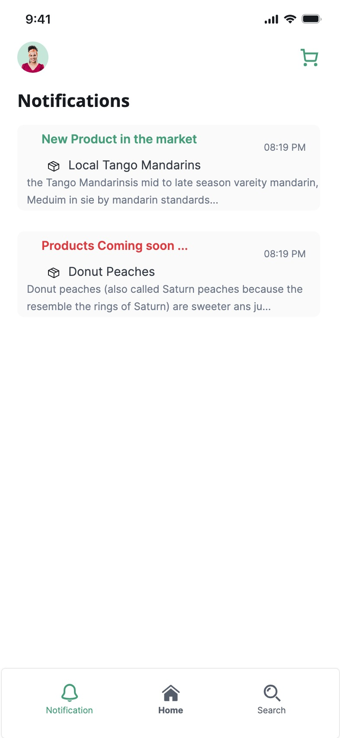
Our Platform

Slide 9
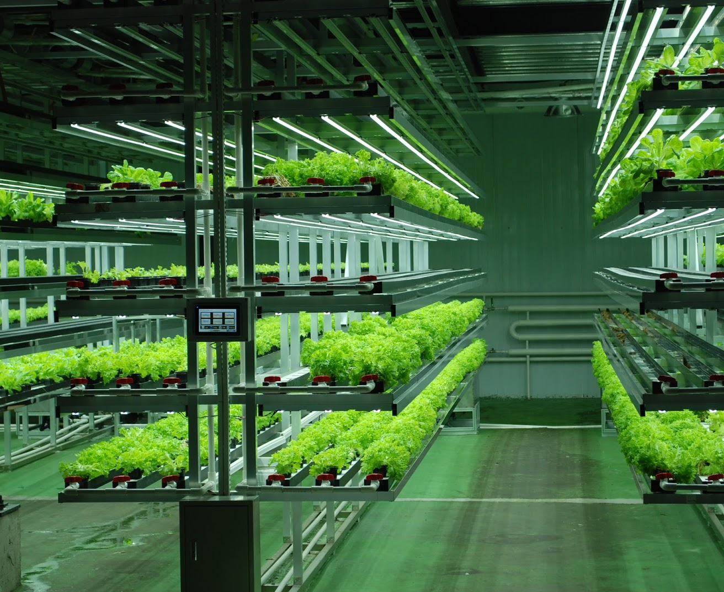
Business model
Revenue Stream
Key Partners
Scalability
Subscription to use our Dashboard
Retail of Booth and its food products
Maintenance and upkeep of Green booth
Local Governments
Hotels and Retail chains
Expand to Developing Countries with underdeveloped agricultural sector
Can build up strategic food reserve for countries

Slide 10
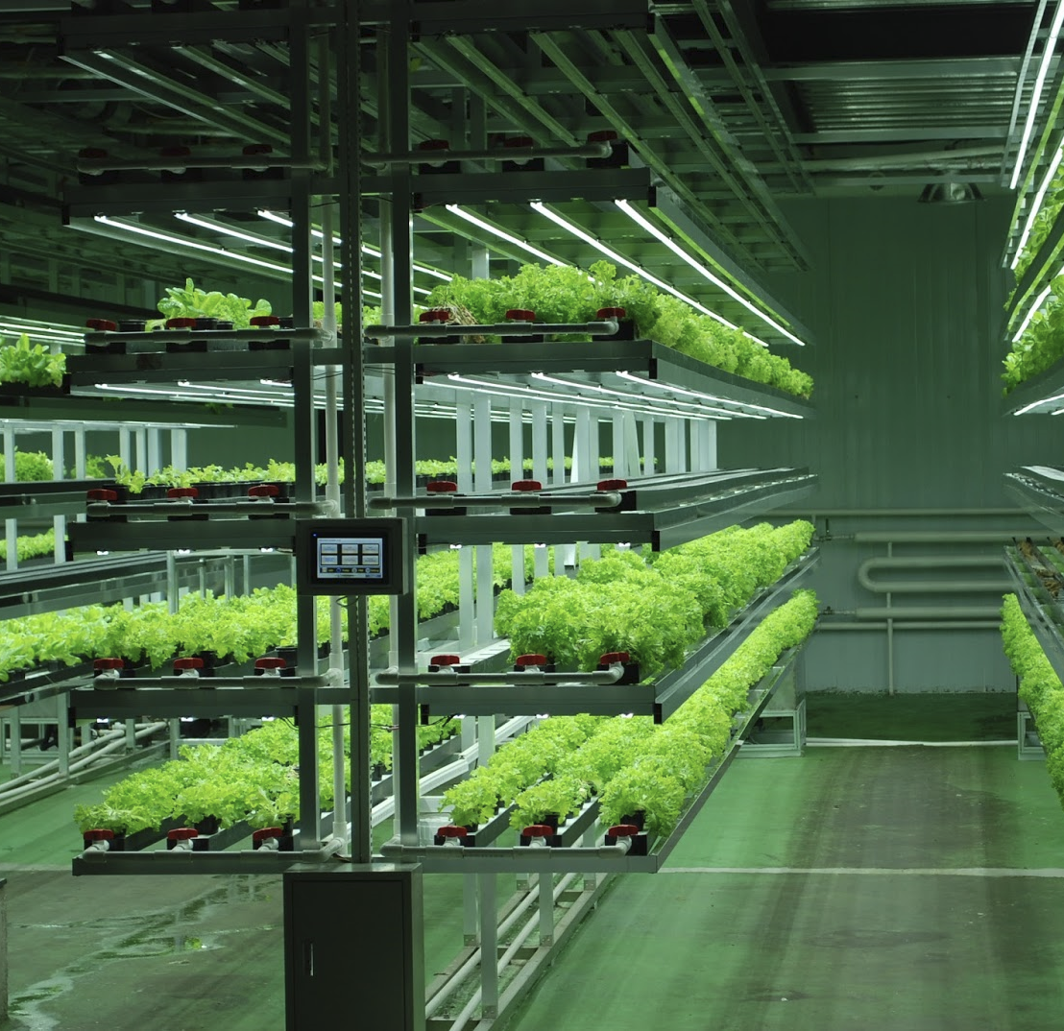
Business Model​
Revenue streams
Local Governments
Retail and Hotel Chains
Scalabilty
Resource-poor countries
Government-held strategic food reserves
Retail of Both and food products
Key partners
Subscription to Monitor and Upkeep

Slide 11
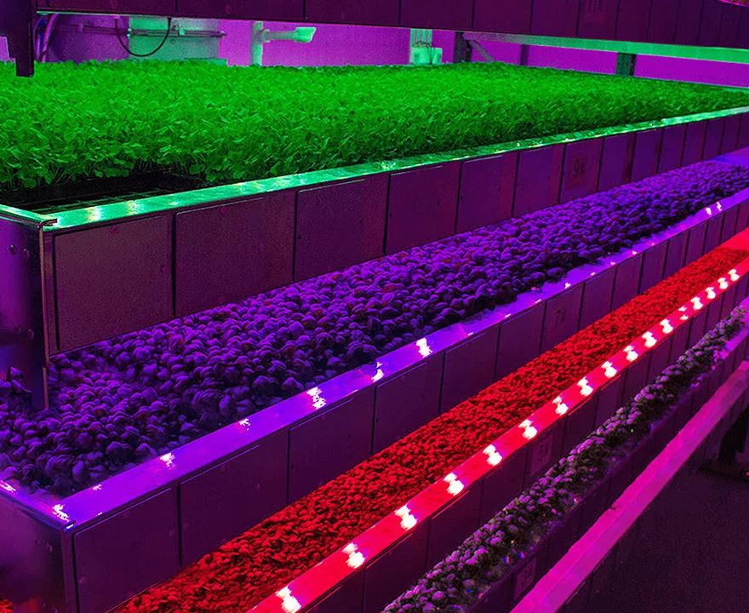
Impact
Green Advocates
Local Government
Sustainability
Extra source of income
Grow some of their own food in house
Emotional bond with the plants they own
Better Understanding of Sustainable farming practices
A Source of sustainable food
Less Water usage per capita
Less Water pollution
Less Fresh water used
Less Fertilizer produced and used
Less food waste

Slide 12
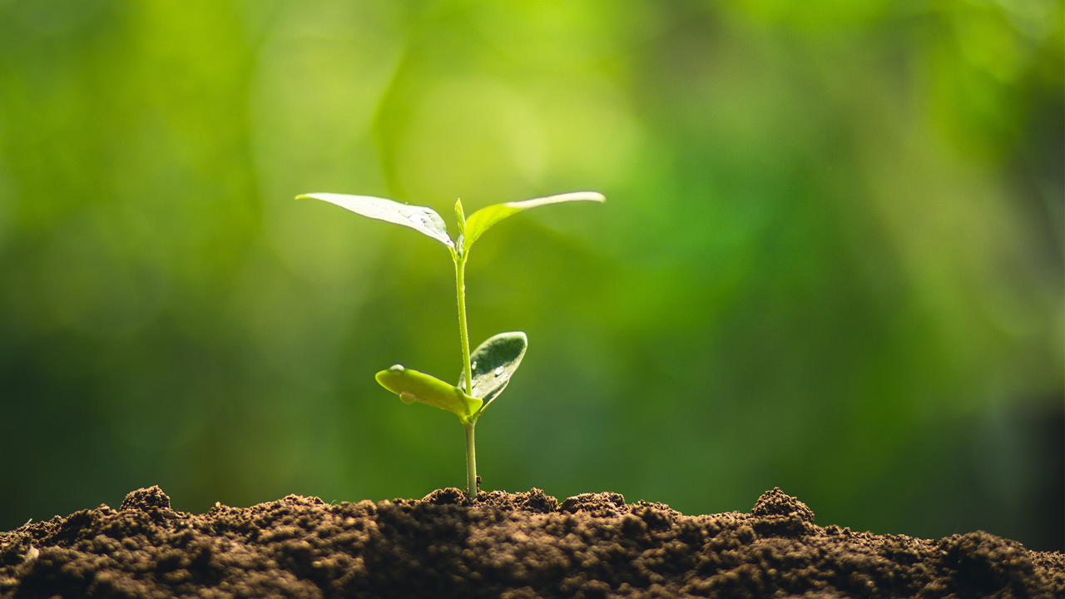
Thank You
Questions?

